Slide 1
Health BUS
Team 13:
Corinne Leonard, Jerome Dixon, Rashi Saini, Viet Tran

Slide 2
Project Description
Creating an application/interface in order to help non-professional caregivers and patients to manage their medications and health records.
Real time interpretation tool that works with medical vocabulary. This would help us better connect with patients and reduce the reliance on interpreters
Create a post-surgery application with daily check-in surveys that can be used by doctors to identify patients at risk of developing dependency on post-op medications

Slide 3
Overview/Goals
Being able to connect to the Patient Portal
Bring in all sources of Health Care data for total integration
Based off total analytical environment -
Spin off microservices for various use cases
Holistic view of all data
Specific Use cases-
Ability to fill and refill prescriptions
Management of medications
Patient engagement for follow-up opioid management
CPIC guidelines
Sending reminders for appointments and taking medications

Slide 4
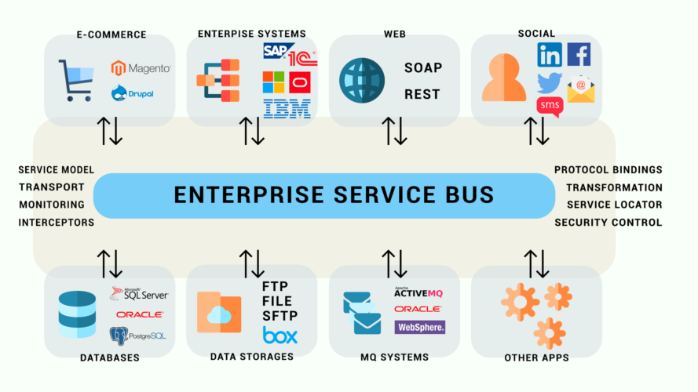

AWS Architecture
R-Studio
MongoDB
Python, Nodejs, Java
NGINX web server
Twitter API
T2.xlarge
EC2 Instance (45 GB)
4 cores
Amazon Services
S3 - File storage
Simple Email Services (SES)
Processing email and email attachments
Ie. Ancestry DNA
Machine Learning Libraries
biomaRt
scikit learn
Xgboost
Keras tensorflow

Slide 5
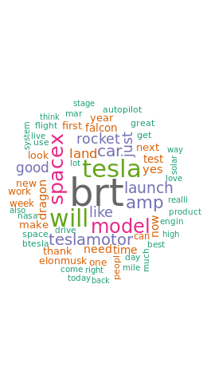
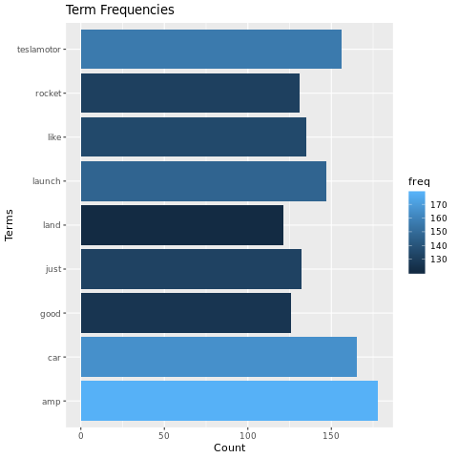
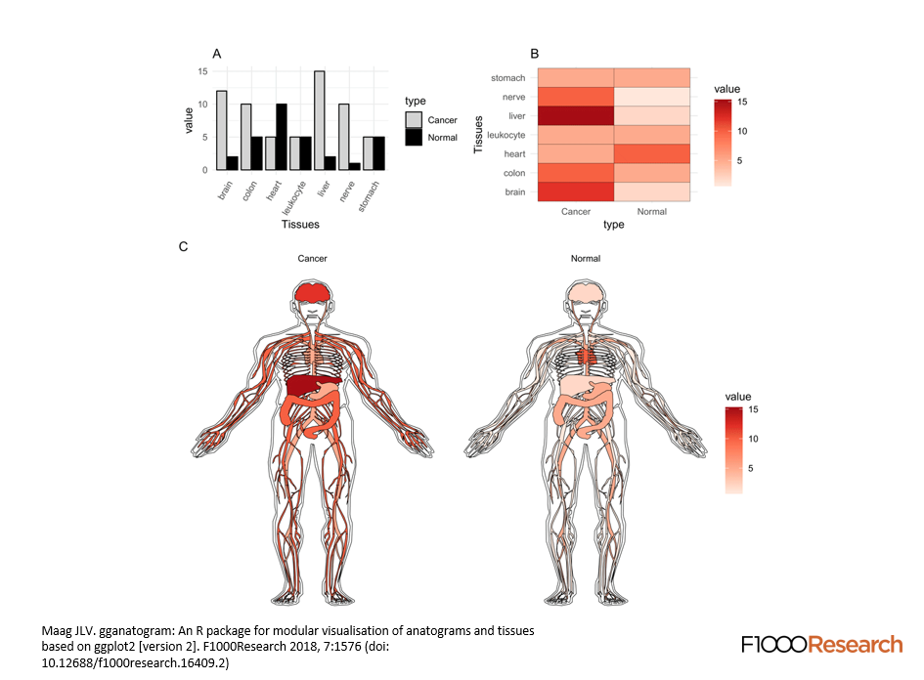
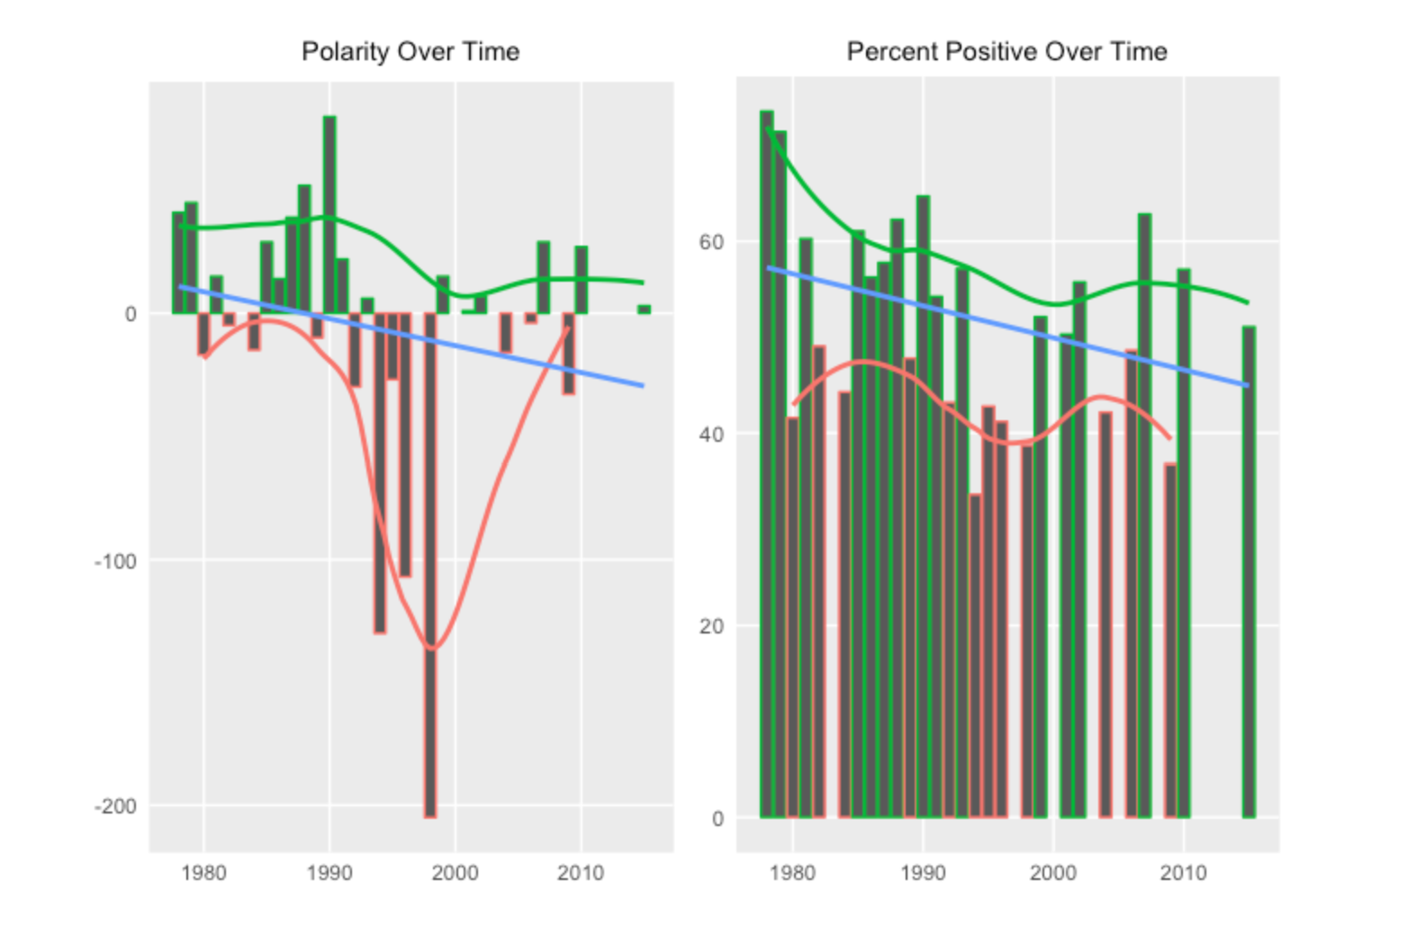
Data Analysis

Slide 6
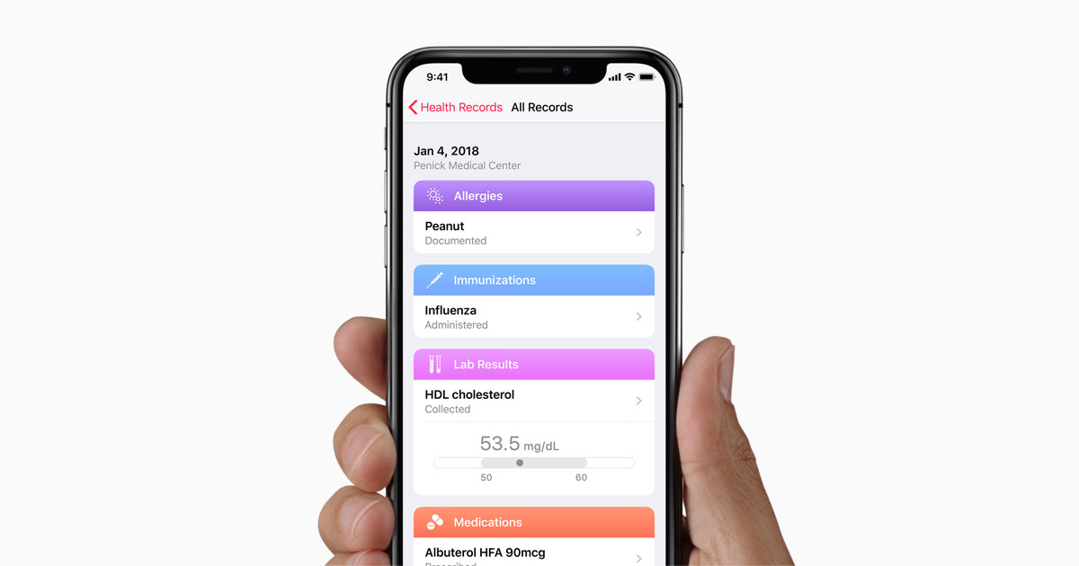
The Future
Apple EHR API

